Slide 1
Efficient Graph Based
Image Segmentation
Darshan Makwana Dec 2022

Slide 2
Contents
Overview
The Algorithm
Running time of the Algorithm
Implementations
Closing Thoughts
Original Paper: http://people.cs.uchicago.edu/~pff/papers/seg-ijcv.pdf

Slide 3
Overview
Rephrasing the problem of Image Segmentation in terms of a graph
An Undirected Graph G=(V, E) where each v_{i} ∈ V corresponds to a pixel in the image and each edge (v_{i},v_{j}) ∈ E has an weight w: E → R associated with it
The weight is a non negative measure of dissimilarity which can be measured with location, intensity or local attributes
The smaller the weight the greater the similarity between two pixels and they can be represented in the same segmentation

Slide 4
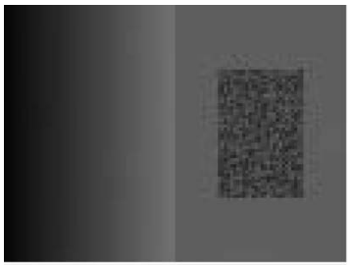
Intuition behind graph based approach
Regions cannot be obtained using purely local phenomenons
Widely varying intensity regions is not a sufficient evidence for boundary region
Graph based method measures evidence of boundary between two regions by measuring
Differences across boundaries
Differences across neighbouring pixels in each region

Slide 5
The Algorithm
Constructing the Graph
Finding Segmentation
A Greedy Algorithm
Existence of a Segmentation

Slide 6
Constructing the Graph
We smoothen out the image with a gaussian blur (σ=0.8) to compensate for the digitization effects
For Colored Images we apply the image segmentation for each channel
Grid Graphs:
Edges are connected in an 4 - connected sense
Weights are taken as the absolute difference of pixel intensity
Nearest Neighbour Graphs:
Edges are connected between all the points within some fixed distance d
Weights calculated using euclidean distance between two pixel vertices

Slide 7
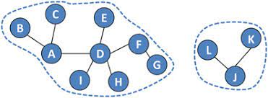




Finding Segmentation
The Evidence (D) that a boundary exists between two strongly connected ( forest tree )
components in a segmentation (S) is measured using dissimilarity of pixels
Measure of Dissimilarity along the boundary:
Measure of Dissimilarity within each component :

Slide 8
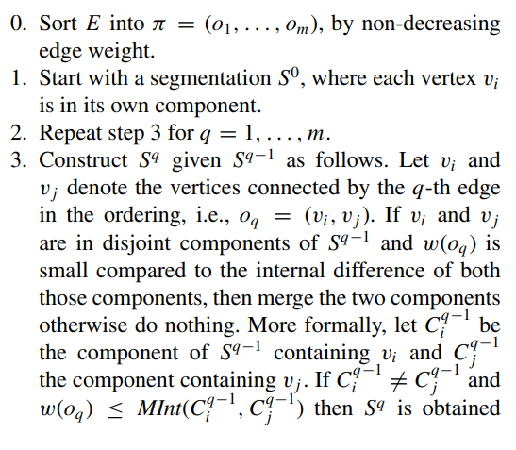

A Greedy Algorithm
At each step of the algorithm we choose the edge that has the minimum weight connecting any two component and check for the predicate
The Reason being it is more likely for the predicate being true for edges with smaller weights that with larger weights
So we sort the edges according to their weights and check for the predicate iteratively at each step

Slide 9


Slide 10

Running time of the Algorithm
Step 0 can be done in O(m) time
Step 1-3 Can be done in O(ma(m)) time where a is the inverse ackerman’s functions because checking for a predicate is completed in constant time and finding the root and merging them can be accomplished in a(m) time
a(m) <= m for practical purposes

Slide 11
Existence of a Segmentation
Def 1) A segmentation is too fine if no evidence of boundary between two components C_{i}, C_{j} ∈ S
Def 2) A segmentation is too coarse if there exists a proper refinement of S that is not too fine
There always exist a segmentation that neither too coarse nor too fine
The proof is quite trivial to see

Slide 12
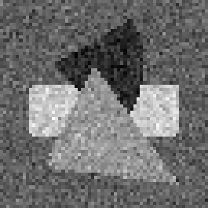

Implementations

Slide 13


Implementations

